Slide 1

LINUX – THE LINUX FILE SYSTEM PART 2
Docente: Dott. Daniele Gobbo Modulo 3

Slide 2
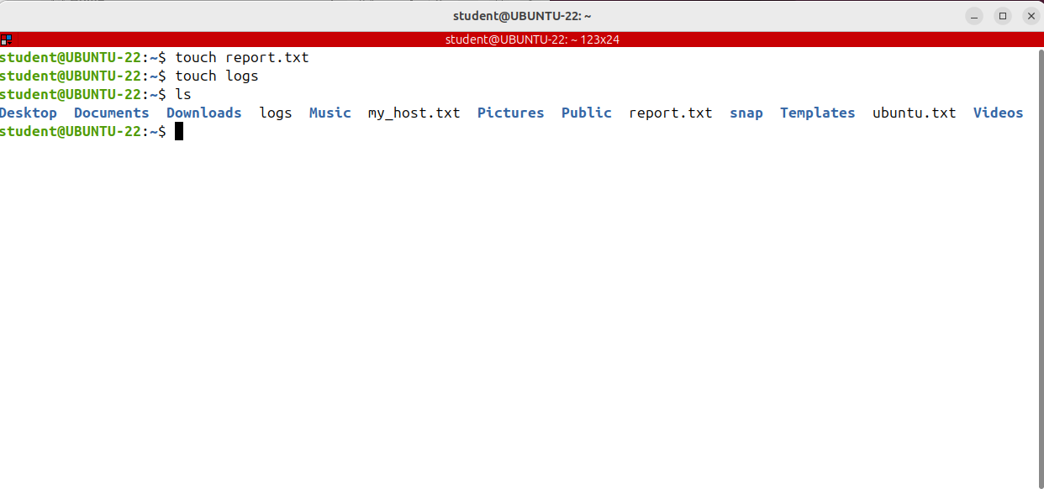
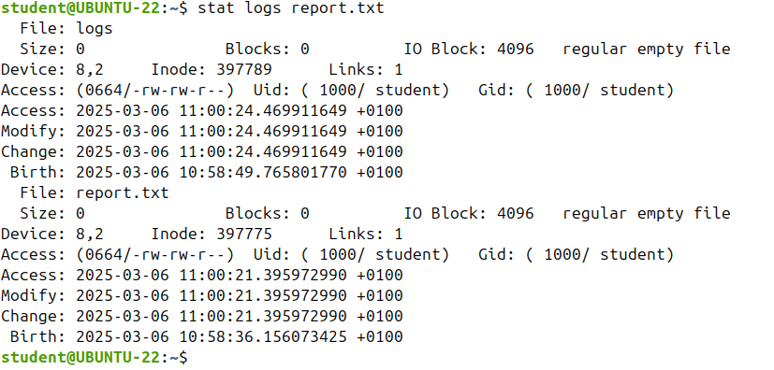
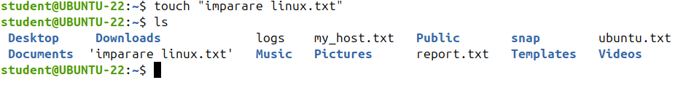
Creating Files and Directories (touch, mkdir)
To create a new file in Linux, you have to use the touch command.
The touch command takes as argument one or more files. If those files already exist touch will update the files timestamps to the current system time.
But if the files do not exist, then touch will create them.
Remember that in Linux case matters, so a file called Report.text, which starts with a capital R, is a complete new file

Slide 3
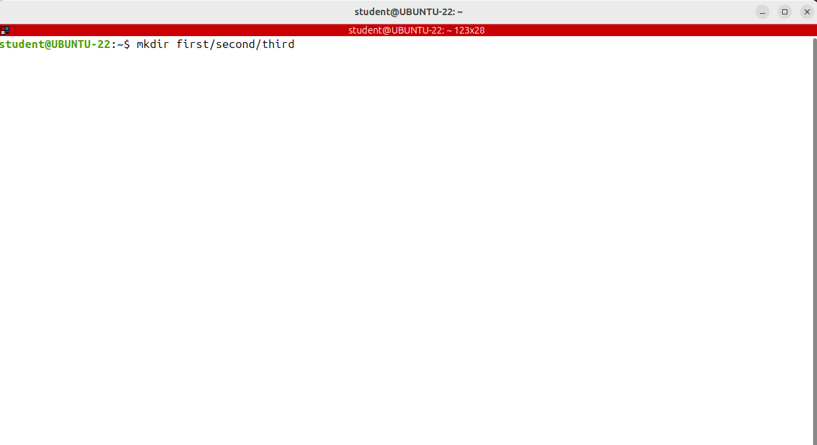
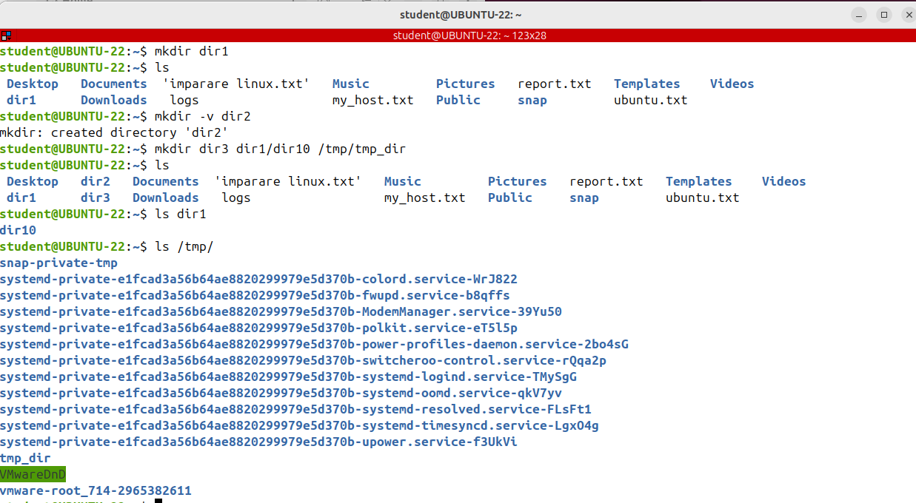
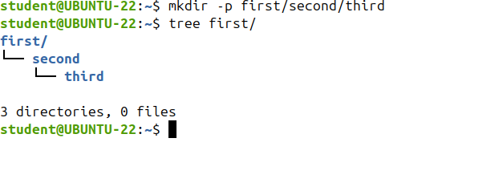
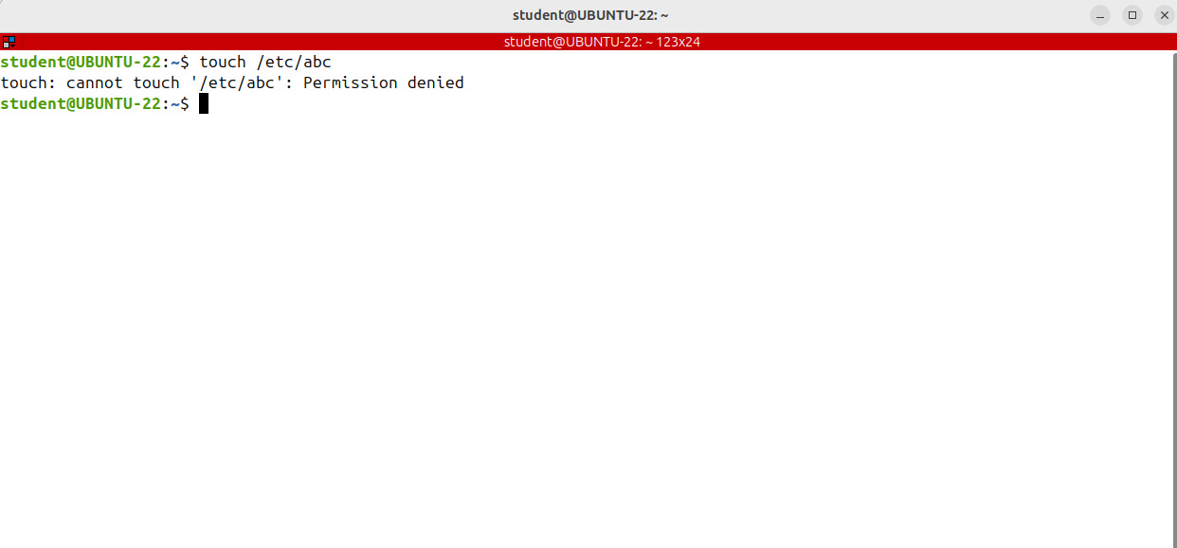
Creating Files and Directories (touch, mkdir)
It's important to note that the user executing this command must have enough permissions to create the file in the parent directory or he will get a permission denied error.
IS IT CORRECT?
I want to create a new directory called first in the current directory, inside first, another directory called second, and inside it, a directory called the Third. Note that none of these directories exists.
Let's move on and see how to create a new directories using the mkdir command.
mkdir comes from “make directory”.

Slide 4
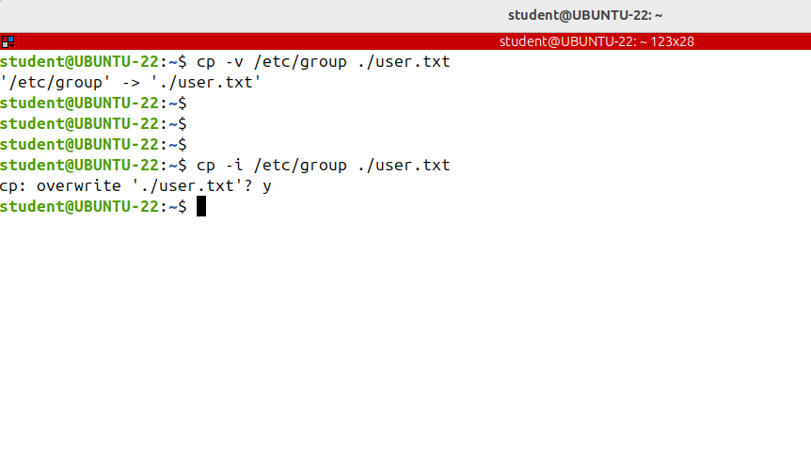
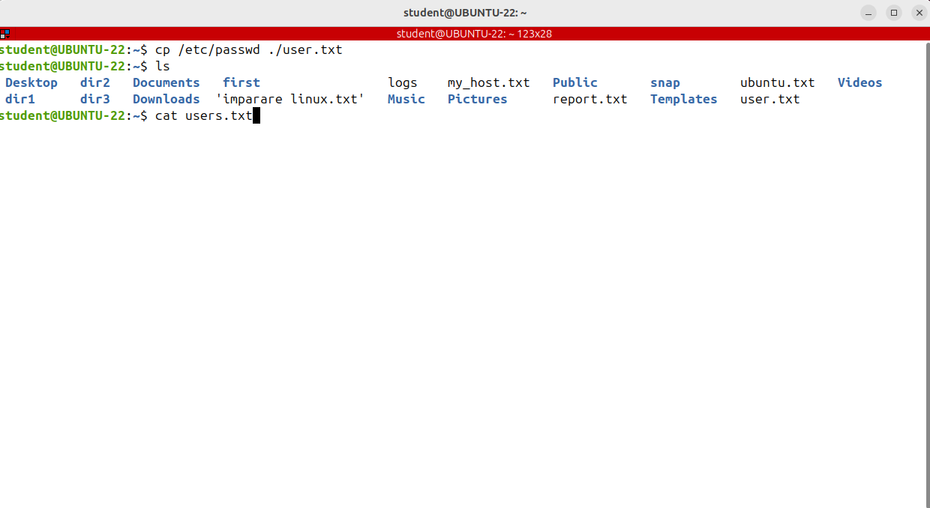
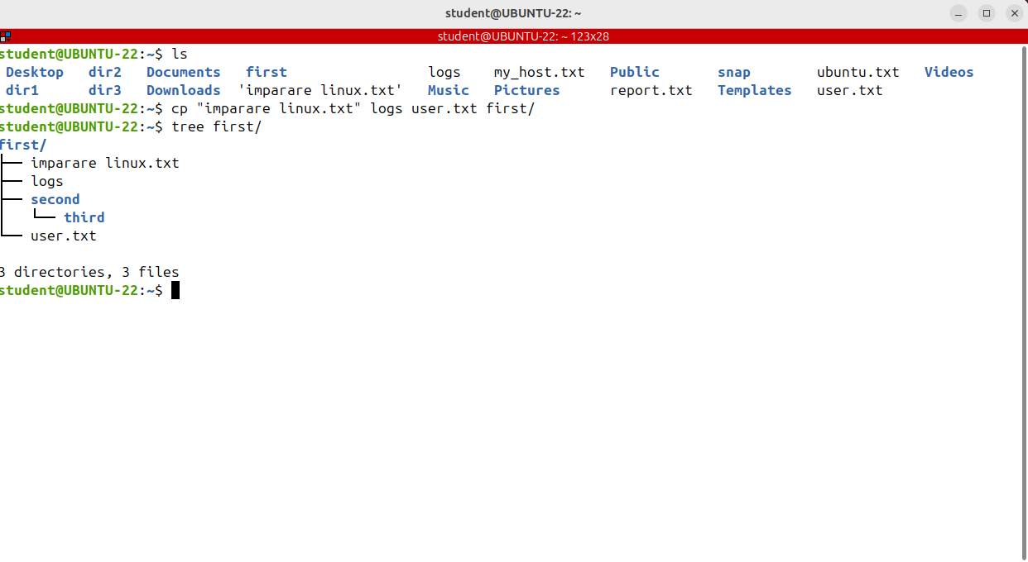
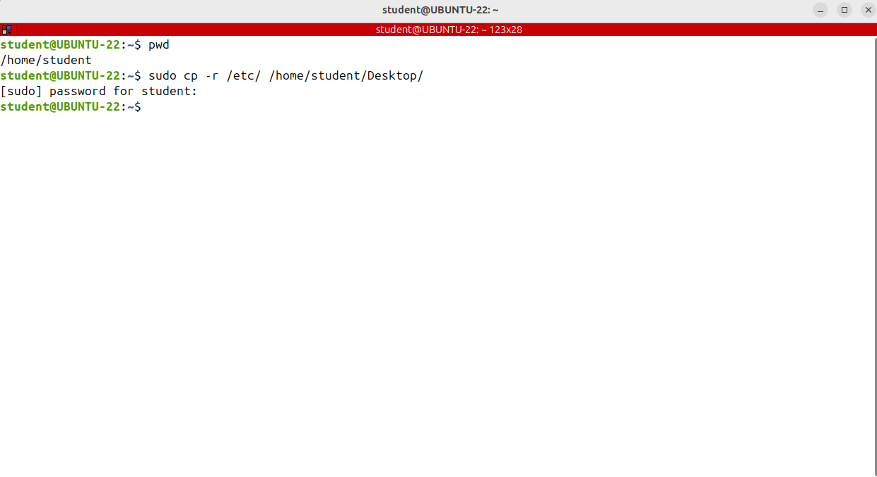
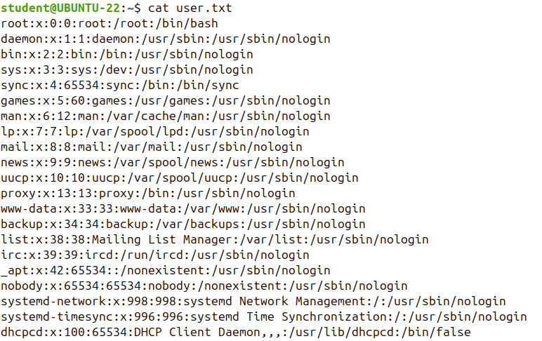
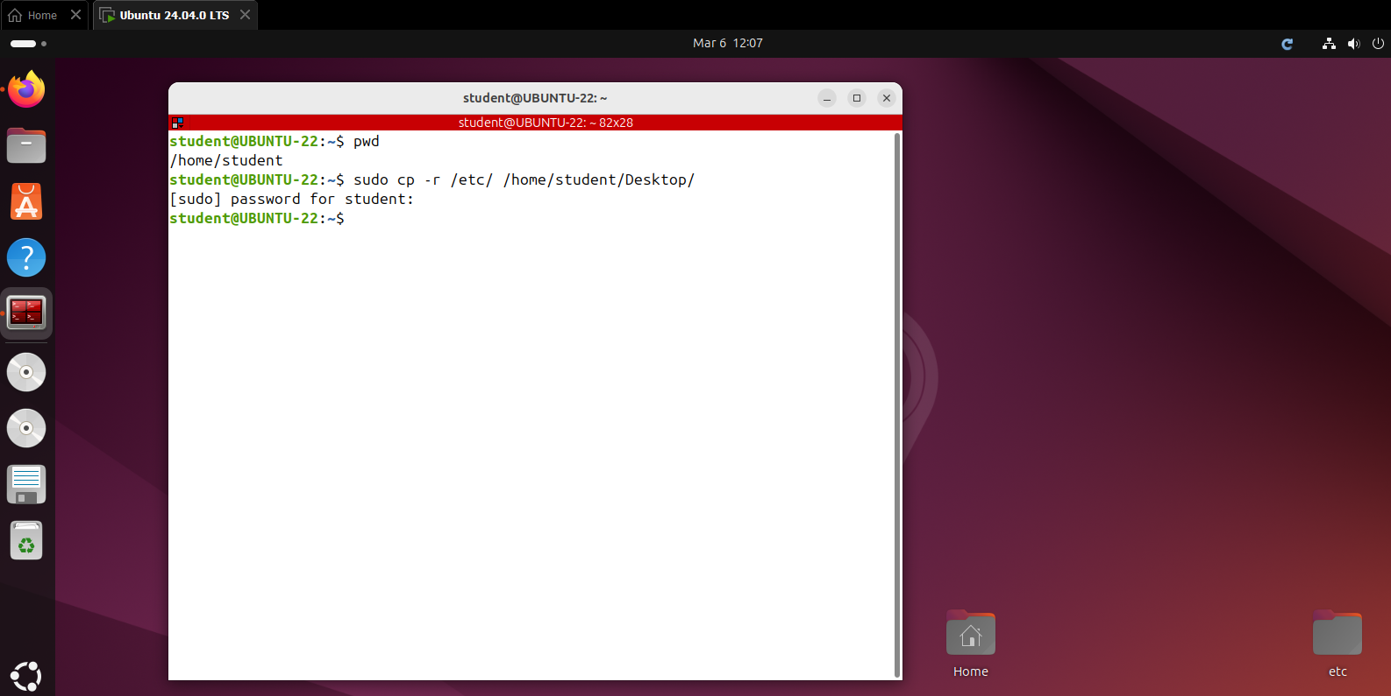

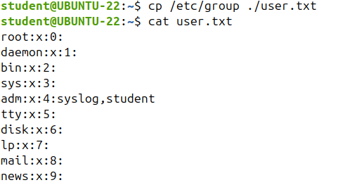
Coping Files and Directories (cp)
cp has three principal modes of operation, depending on the number and the type of arguments passed.
If the command has two arguments of type files, it copies the contents of the first file to the second file.
If the second file does not exist, cp will create it.
But if it already exists, cp will overwrite the destination file.
The third and the last mode of operation is when all arguments are of type directory.
In this case, cp copies all files in the source directory to the destination directoy creating any files or directories needed.
This requires -r, an option that indicates the recursive copying of directories.
The second mode of operation is when cp has one or more arguments of type file, which is the source and the last argument of typed directory, which is the destination. In this case, it copies the source files to the destination directory, creating any files that do not already exist in the destination.
OVERWRITE

Slide 5
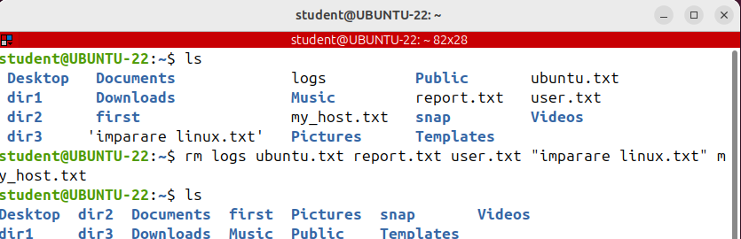
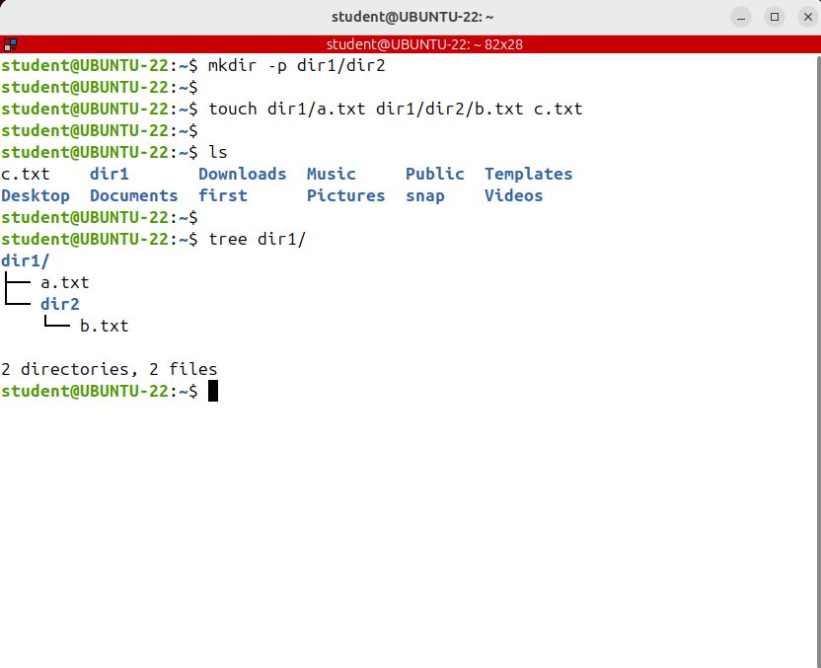

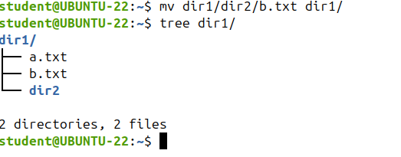
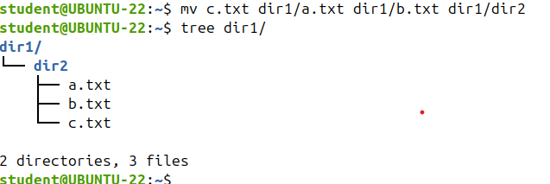
Moving and Renaming Files and Directories (mv)
The mv command is a command line utility that moves one or more file directories from one place to another.
This command has two distinct functions.
It moves files and directories or it renames files and directories; yes, there is no mistake, you can use mv both for moving and for renaming files.

Slide 6
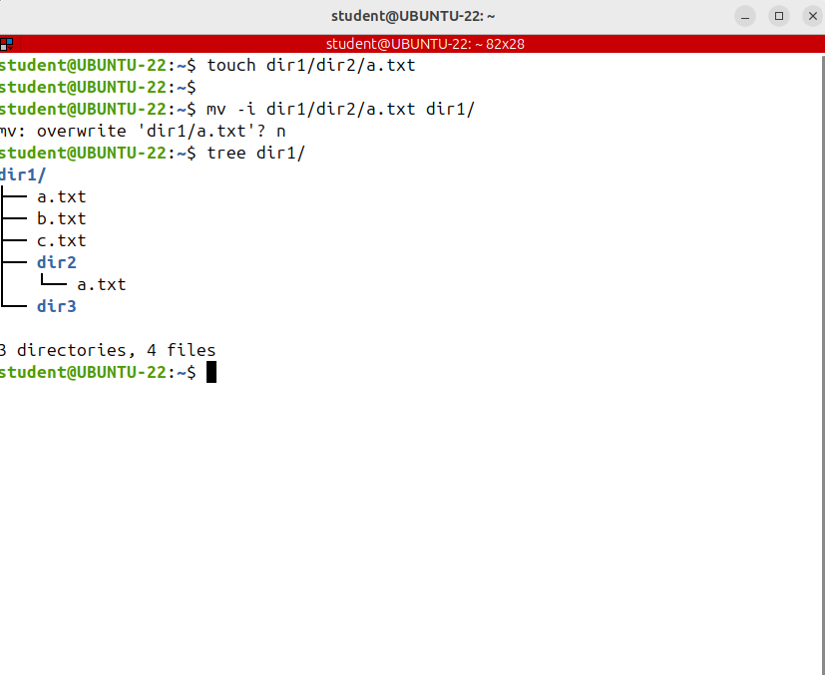
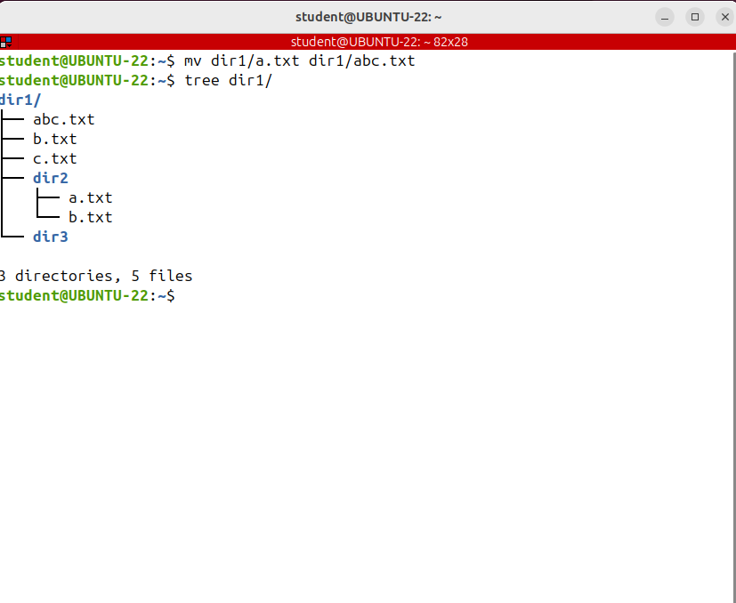
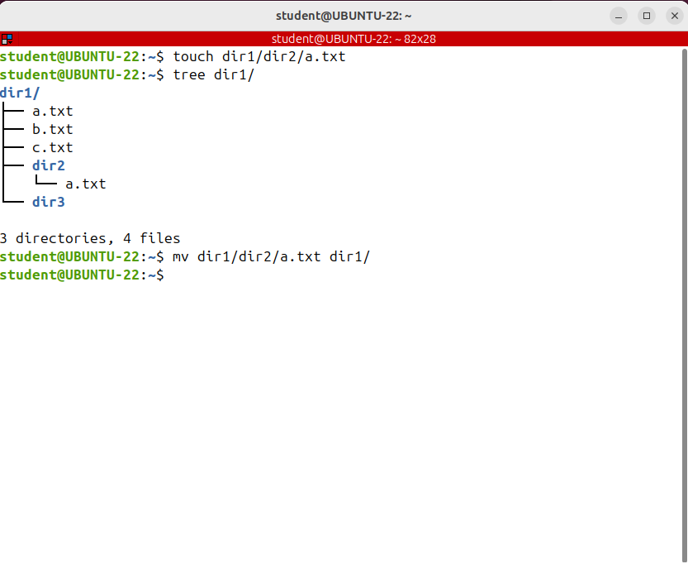
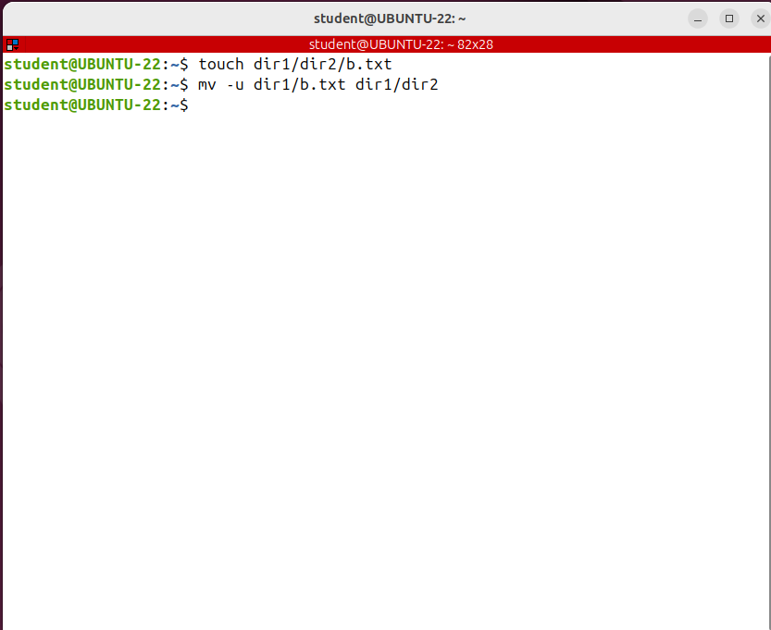
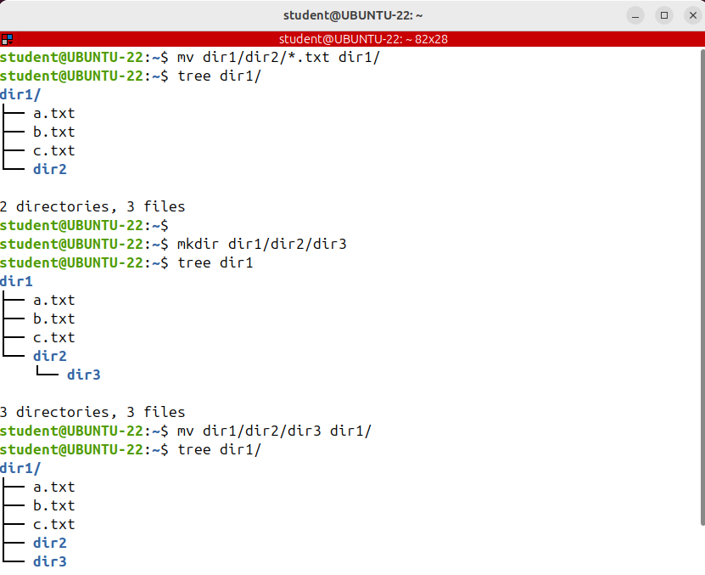
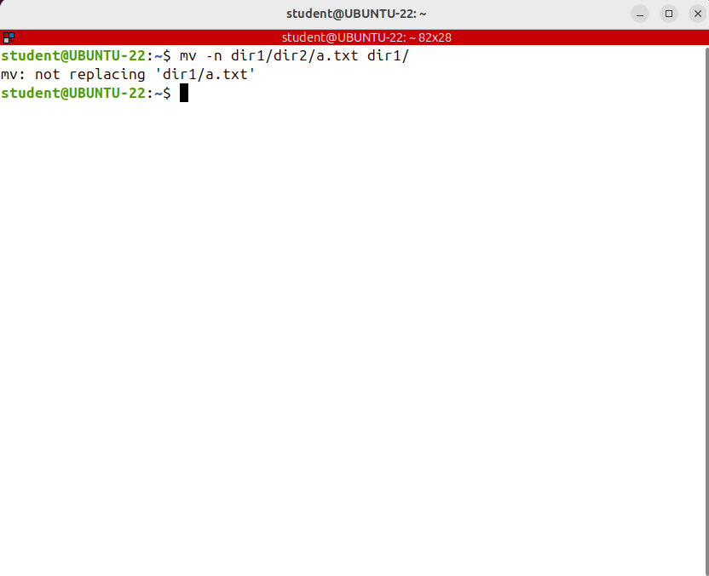
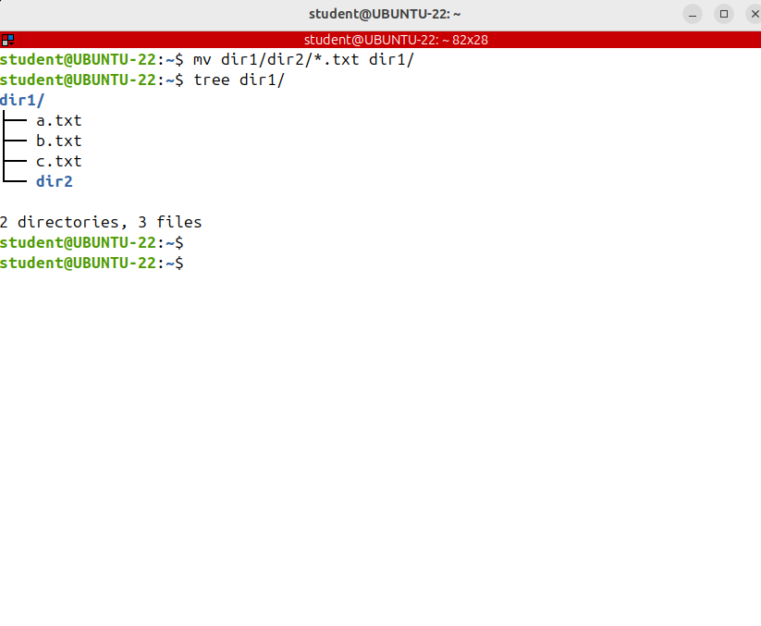
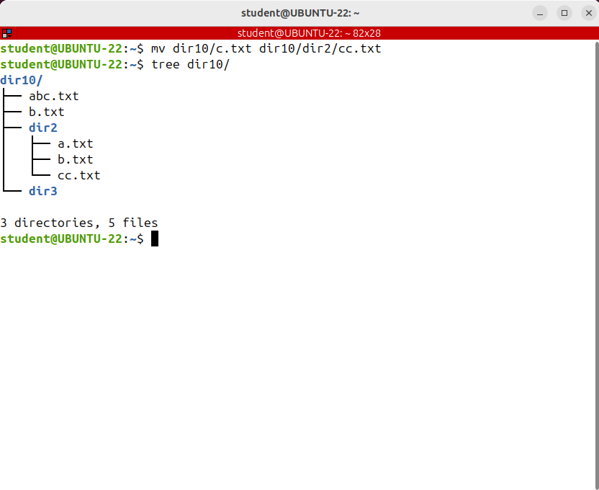
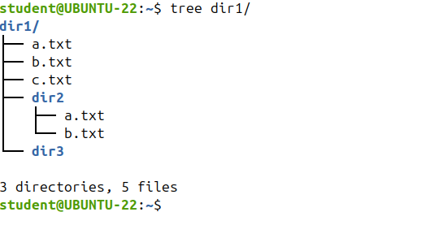

Moving and Renaming Files and Directories (mv)
v
Renamed!
Now, let's see what happens if the destination file already exists.
What do you think? Has it moved the file?
v
Another useful option is -u or --update
When using this option, it will move only when the source file is newer than the destination file or when the destination file is missing.
This guarantees that only newer files will be moved.
This is especially useful in Shell scripts.
Same thing for directory
v
b.Txt was not remove
mv can be used to both move and rename files. If the source file is in the same directory as the destination file then mv will rename it.
And the file was moved and the destination was overwritten without prompting; to prompt before overwriting a file, the -i option can be used;
To prevent an existing file from being overwritten, use the -n option.
This causes the mv command to ignore anything that would override an existing file.
you can even move the file to a different directory and rename it at the same time.
I'm moving c.txt from dir10 to dir2 renaming it at the same time

Slide 7
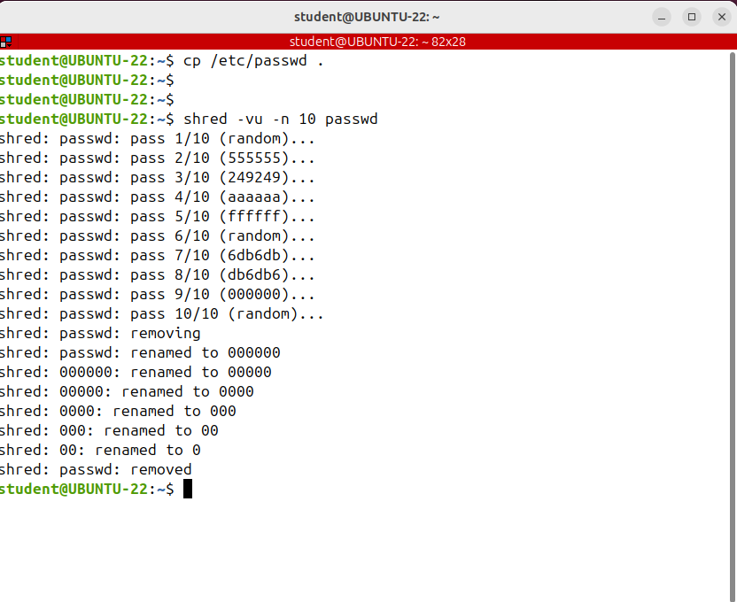
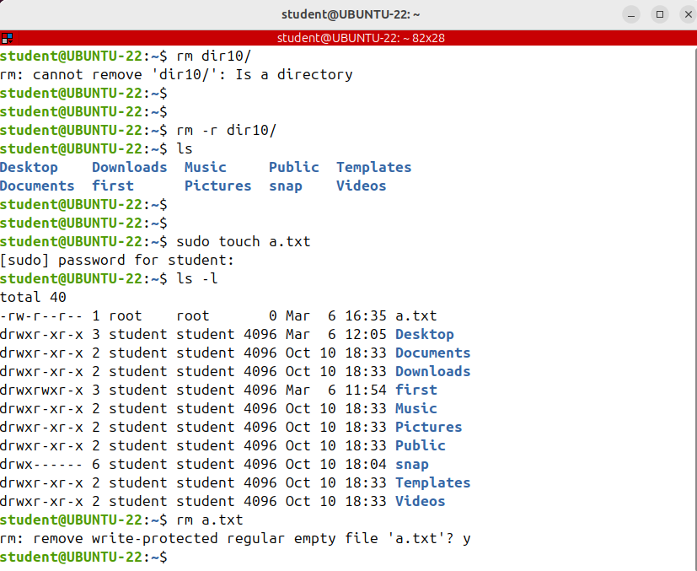
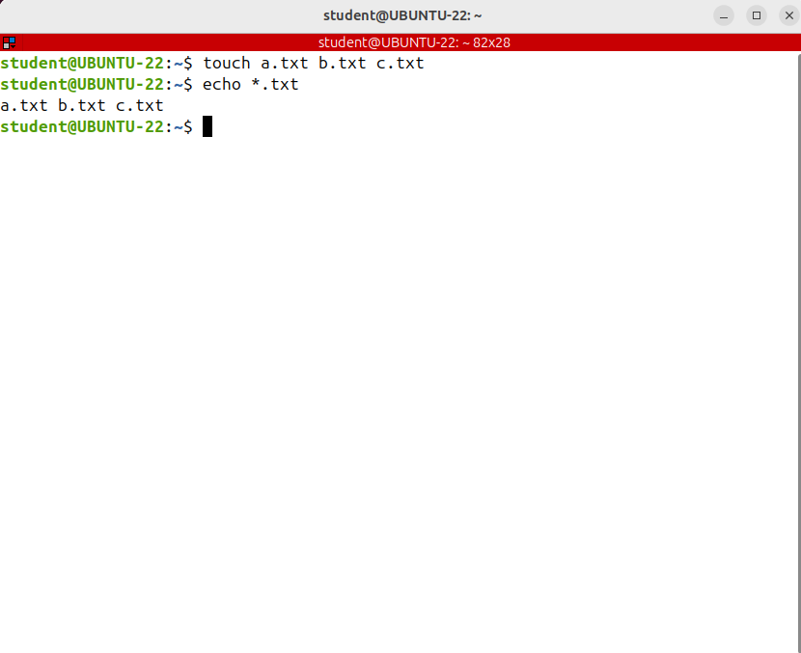
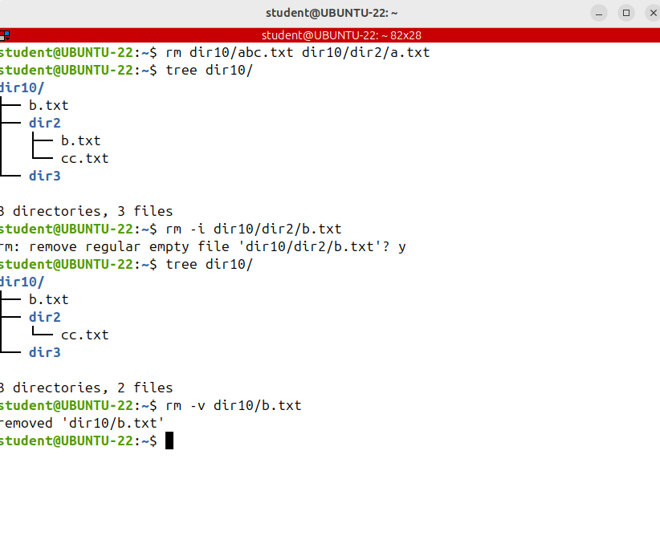
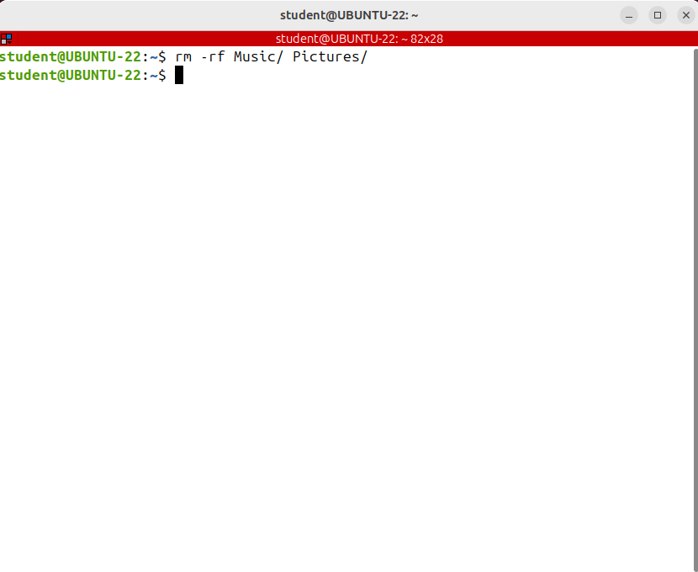
Removing Files and Directories (rm, shred)
My second advice is to pay special attention when using pattern matches and wild cards like asterisks, dots or question marks.
This is also applicable to other possible destructive commands, not only rm.
Before running a command like rm *.txt execute echo and the pattern, to see exactly what are the files that will be matched. Sometimes these patterns expand in names you don't expect to.
So before executing this command
execute echo and the pattern to see which files will be matched.
the rm command does not actually delete a file.
Instead, it unlinks it, meaning the data is still on disk.
The space on disk occupied by the deleted file is marked as being free and can be used by other file or process. Now depending on different factors that are professional solutions that make the recovery of the deleted files possible.
This is available to any other operating system, including Windows, Mac or Android.
So if you remove a file, you can't be 100 percent sure that no one will ever recover it.
If you are run it as root and make a mistake then your files are gone.
You cannot recover them.
As I said before, there isn't such a thing as a recycle bin, a trash or the undo remove command; to stay in the safe zone
my advice for you is: pay special attention when removing files as root and always, but always, use tab for auto completion.
-v means verbose or showing the process -u means removing the files after overwriting.
and -n and an integer number N, overwrites the file N times instead of the default, which is 3.
The file was overwritten with random contents before removing
BUT
if you want to keep your confidential data secure, you have to encrypt it.
You cannot rely on simply deleting a file and suppose that no one could ever recover and access it.
In Linux to remove files or directories from the command line use the rm command. Be extra careful when removing files or directories, because once the file is deleted with the rm command it cannot be easily recovered.
There isn't such a concept as the recycle bin or trash for the files that were removed from the command line.
What you can do is use the shred command instead. shred overwrites a file to hide its contents many times before removing. Let's see an example. I'm copying the password file from etc to the current directory.
Just imagine that you have to remove hundreds of files from a directory and you have to confirm each removal.
It's impractical! To force removal and not receive a prompt pass the -f option.
How can we protect from recovering?
Let's see how to remove directories; if you try to remove a directory as you would a file, you'll get an error.

Slide 8
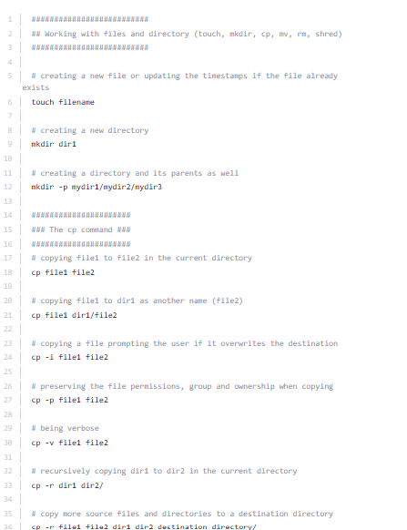
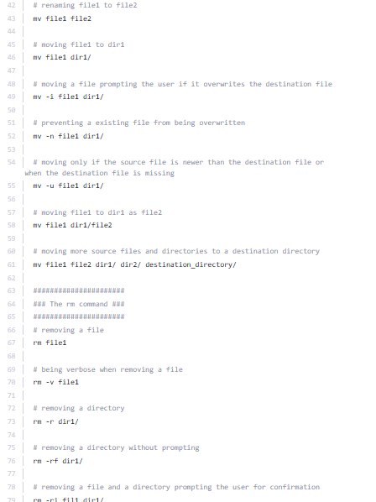
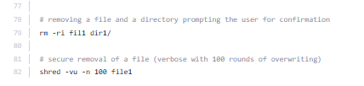
Commands - touch, mkdir, cp, mv, rm, shred

Slide 9
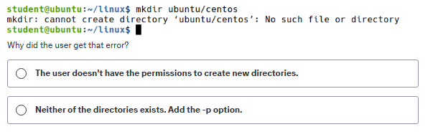
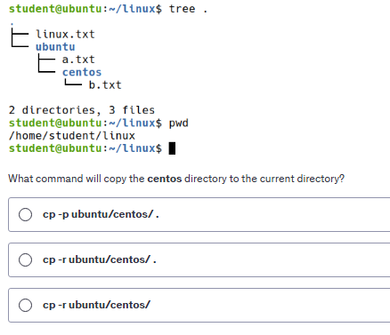
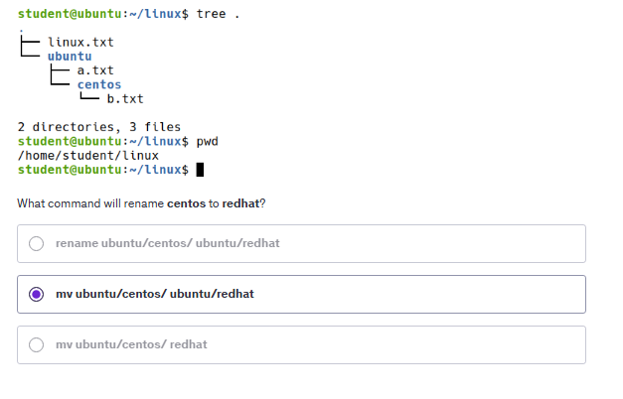
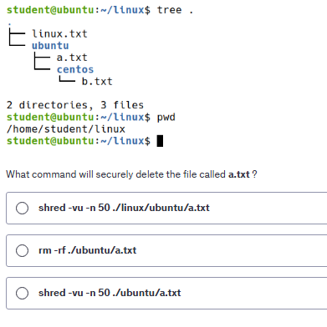
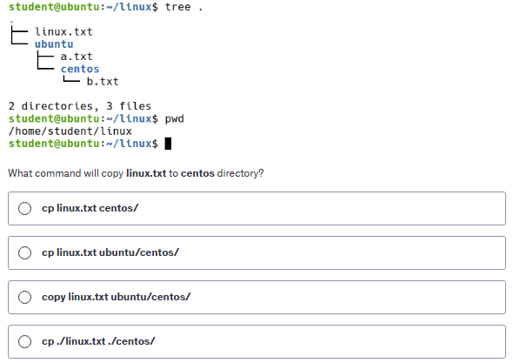
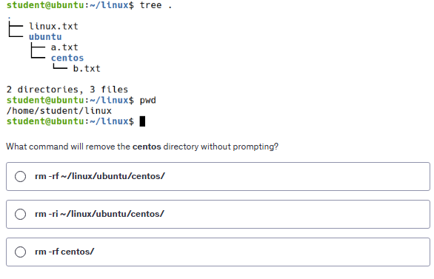
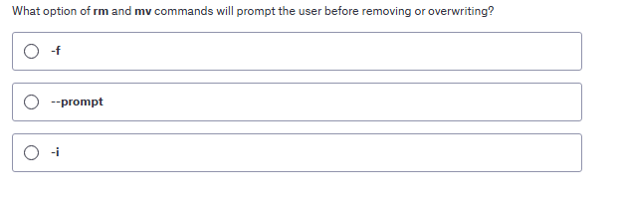

QUIZ TIME

Slide 10
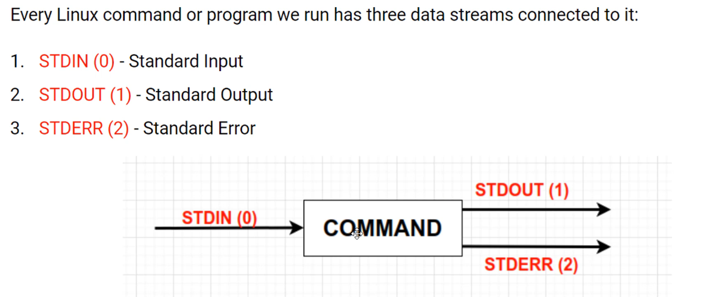
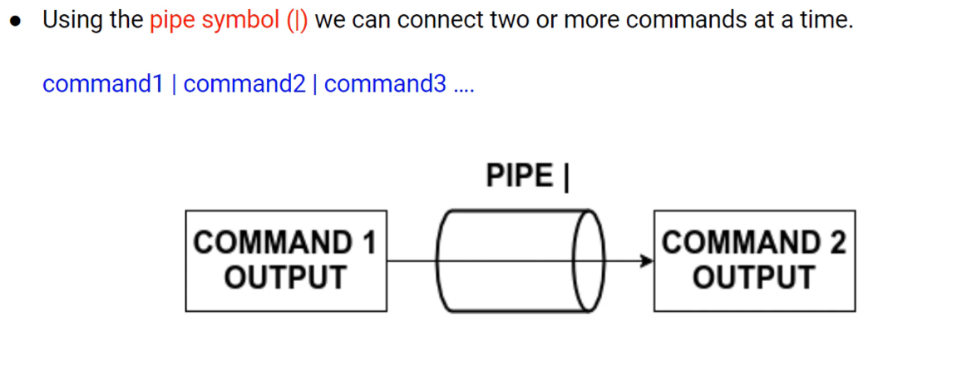
Working With Pipes in Linux (|, wc)
Pipes, which are one of the most useful command line featuresin Linux. Pipes are used in countless ways and are just about everywhere.
represents data fed into the program or the data the program is working with
Pipe lets us send the output of one command as input to another one. Piping and redirection are the means by which we may connect these streams, input output and error among programs and files to direct data in interesting and useful ways.
data printed by the program, by
default to the terminal
for error messages and also defaults to the terminal.

Slide 11
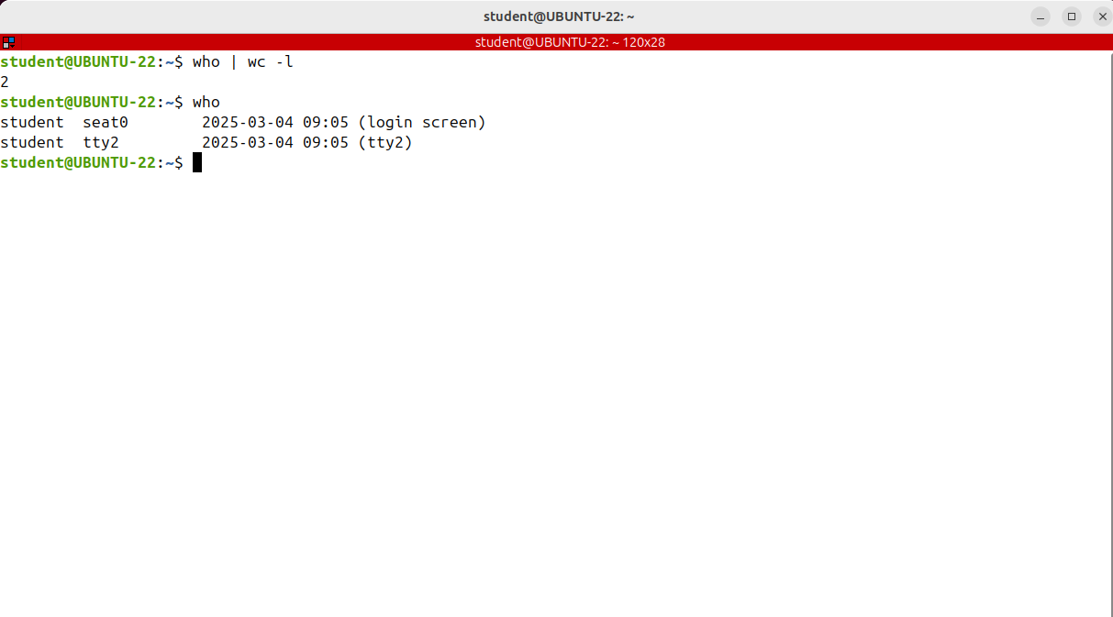
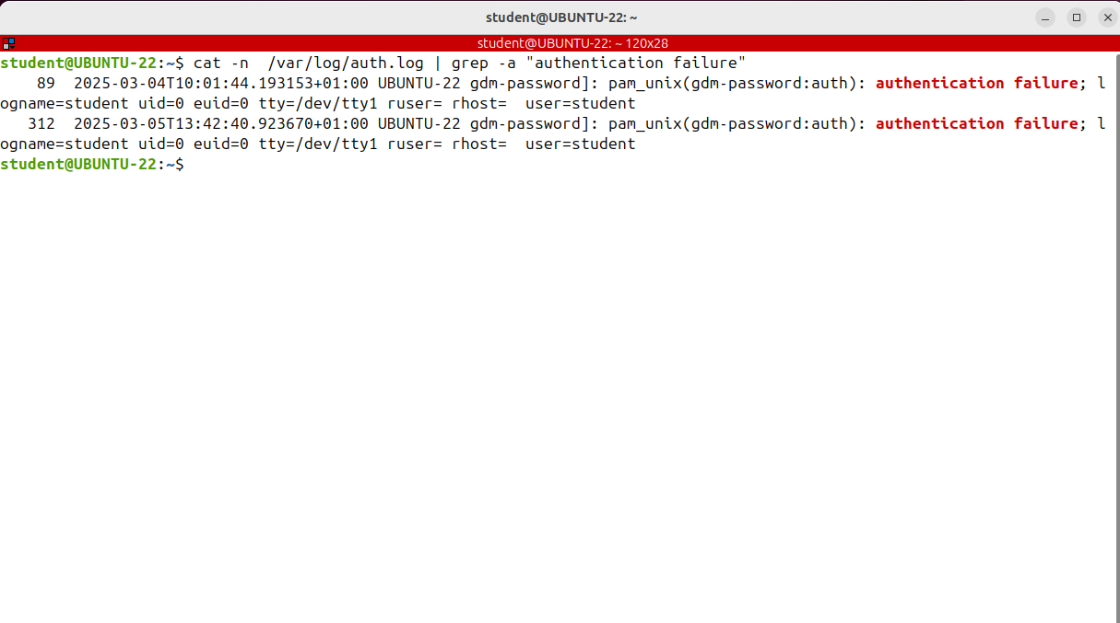
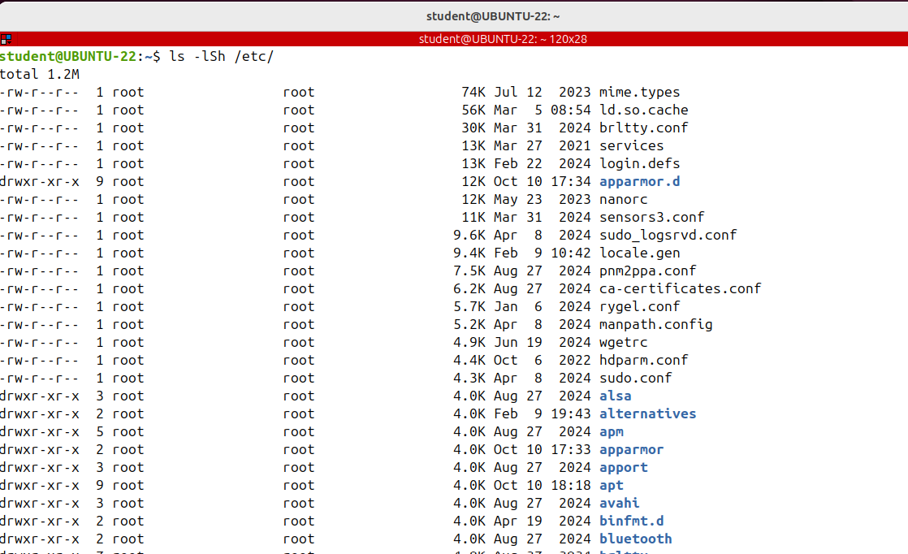
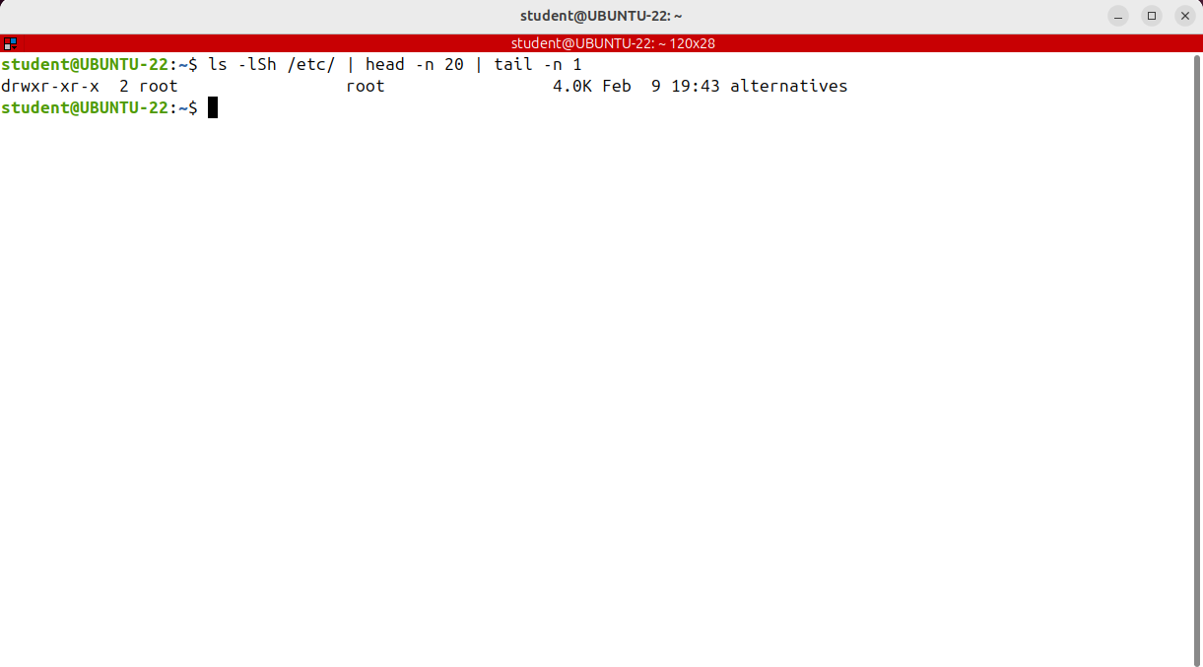
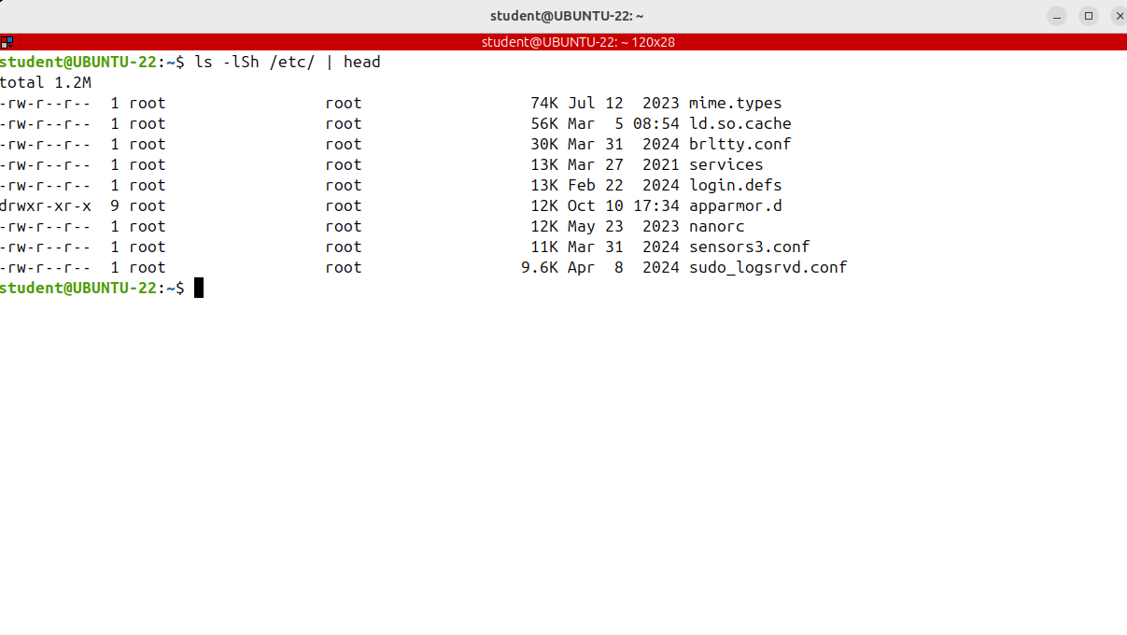
Working With Pipes in Linux (|, wc)
The command has listed all files in the etc directory sorted by size in human readable. There are lots of files, and I finished up seeing only the last ones, the smallest files; the largest ones are at the beginning and I have to scroll to see them.
What I could do is connect the ls command with the head command. Using a pipe I'll send the output of the first command, which is the ls as input to the second command.
One of the main purposes of piping is filtering.
You use piping to filter the contents of a large file to find the particular string or a word for example.
Note that when you use a pipe, you are not running a single command, but each command
in the pipe starts.
I want to see how many lines were found. The output of the grep command will be given
to another command called wc, which counts how many lines were given.
I want to find out how many authentication failures took place. There isn’t such a command in Linux, so I have to build my own using pipes.
I want to see how many users are logged in.
Who is displaying the logged in users, so who | wc -l

Slide 12
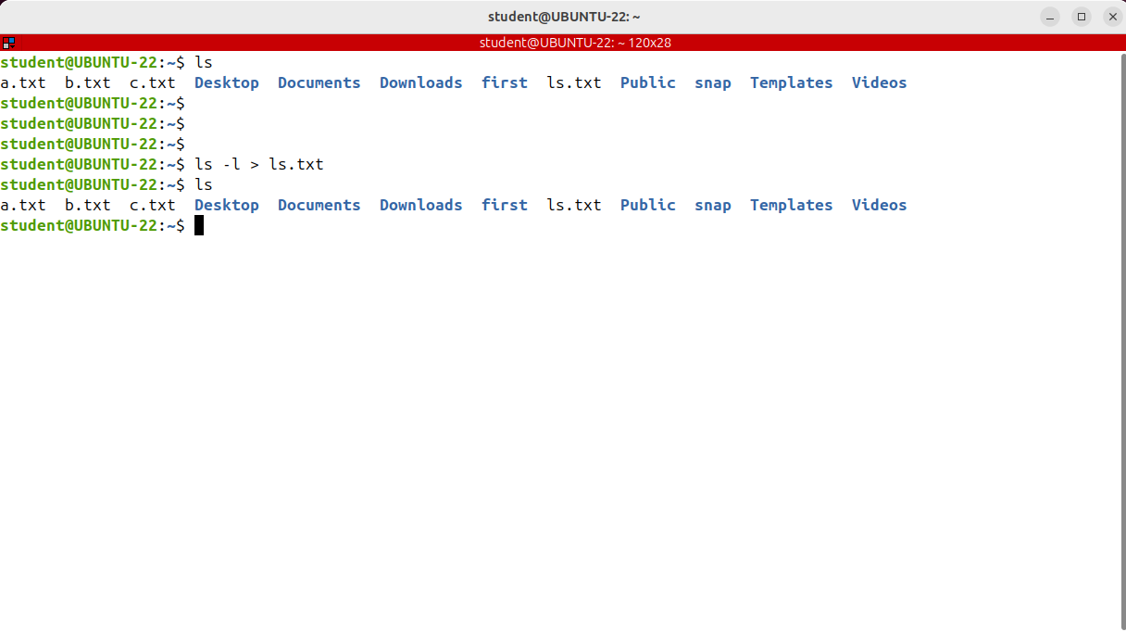



Command Redirection (>, >>, 2> &>, cut, tee)
We want to see how to redirect a command output to a file
Every command you run has three data streams connected to it: STDIN (0) or Standard input, STDOUT (1) or or Standard Output and STDERR (2) or Standard error.
Normally, when we run a command, we want to see the output on the screen, in the terminal.
This is convenient most of the time, but sometimes we may wish to save it to a file
Overwritten
If we don't want to override the file, we can instead append or add to the end of the file by using the double greater than operator ( >> )
What will happen if you redirect it again to the same file. I'm redicting the output of another command to the same file?

Slide 13








Command Redirection (>, >>, 2> &>, cut, tee)
We want to talk about error redirection.
The three streams, attached to any Linux command actually have numbers associated with them.
You see the numbers between parentheses. STDERR is stream number 2 and we use these numbers to identify the streams.
Standard output
It's also possible to redirect both the normal output and the error messages of the same command.
Now we want redirect both standard output and standard error to the same file.
What I'll do is redirect standard output to a file and the standard error to standard output
You can also combine command reduction with pipes.
Let's take a look at an example.

Slide 14

Command Redirection (>, >>, 2> &>, cut, tee)
What can we do if at the same time we want to store and view the output of any command?

Slide 15

Command Redirection (>, >>, 2> &>, cut, tee)

Slide 16







QUIZ TIME

